Slide 1













Loan Disbursement Trends
– An Analytical Dashboard Project

Slide 2
Table of Contents
Content:
Project Overview (Dashboard Summary)
RBI Borrowings Trend (Line Chart)
Loan Type Distribution (Donut Chart)
Bank Credit Growth Over Years (Bar Chart)
Loan Amount by Type (Column Chart)
Loan Composition & Credit Growth (Line + Column Combo)
KPI Insights & Performance Highlights
Why I Created This Project
Conclusion & Key Learnings

Slide 3
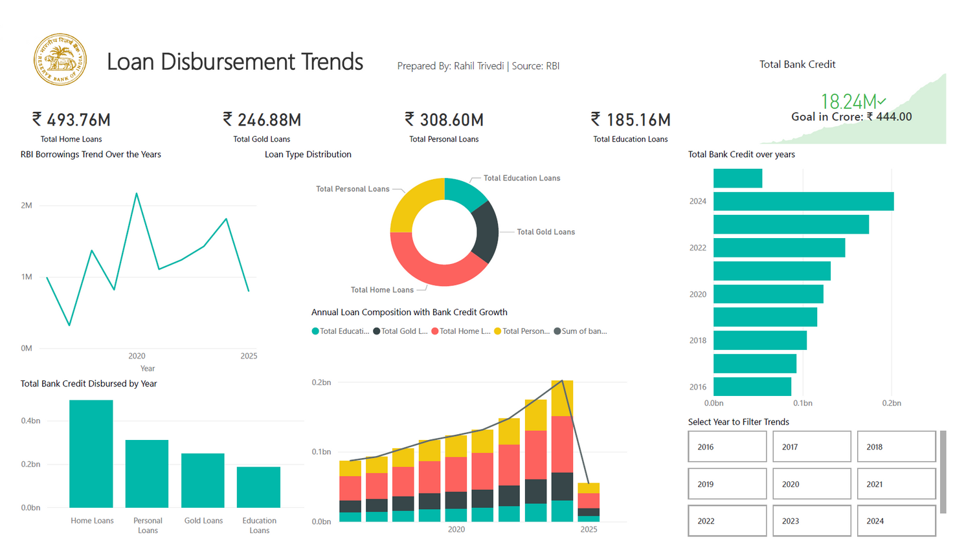
Loan Disbursement Trends – Dashboard Summary
This dashboard showcases multi-angle insights into India’s loan disbursement patterns:
Breakdown by loan types: Home, Gold, Personal, Education
Year-wise borrowing from RBI
Bank credit trends and performance goals
Composition & growth via advanced visualizations
Interactive slicers for filtering year-wise trends

Slide 4
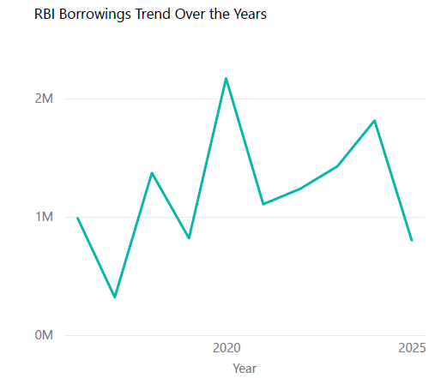
Chart 1 – RBI Borrowing Trend
This line chart shows the trend of bank borrowings from the Reserve Bank of India over the years.
Noticeable spike in 2020, most likely due to the COVID-19 economic shock, when liquidity was needed to support the economy.
Post-2020, borrowings stabilized, indicating policy recovery and stronger fiscal conditions.
The drop in 2025 may be due to data unavailability or lower dependency on RBI lending.
This chart gives macro-economic context to the dashboard.

Slide 5
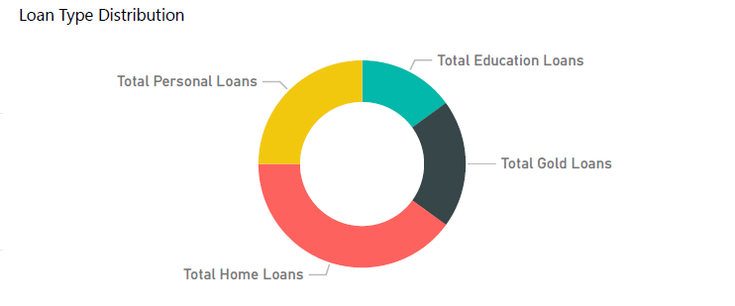
Chart 2 – Loan Type Distribution
This donut chart visually compares the proportion of loan amounts disbursed across four major categories:
Home Loans dominate the portfolio, reflecting India’s booming real estate market and affordable housing schemes.
Gold Loans and Personal Loans are almost equally distributed, often driven by short-term consumer needs.
Education Loans form the smallest share — a point that indicates the need for improved access to academic credit.
The visual helps decision-makers quickly understand loan mix strategy.

Slide 6
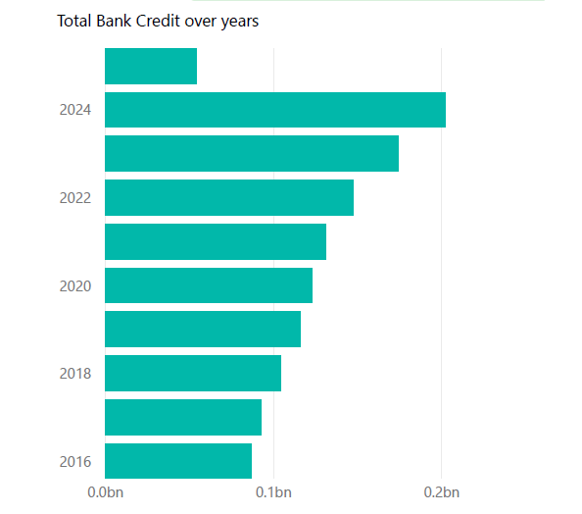
Chart 3 – Total Bank Credit by Year
This horizontal bar chart showcases the total credit disbursed by financial institutions between 2016 and 2024.
There’s a clear upward trend, with 2024 being the strongest year for credit distribution.
Indicates growth in economic activity and a healthy lending ecosystem.
Useful for regulators or institutions looking to assess loan penetration over time.
The year-wise granularity also supports filter-based analysis in the dashboard.

Slide 7
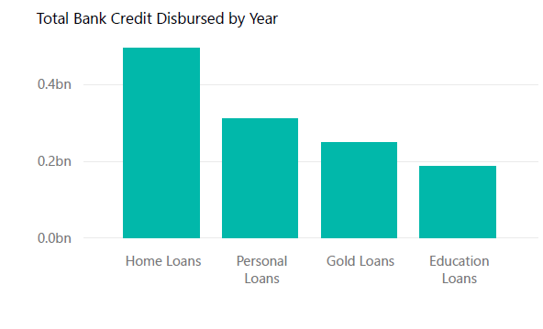
Chart 4 – Total Loan Amount by Type
This column chart reflects the total loan amount issued per loan type from 2016 to 2025.
Home Loans top the list with ₹493.76M in credit — aligning with national housing development agendas.
Personal Loans and Gold Loans follow, indicating their popularity in short-to-medium-term borrowing.
Education Loans, while low, represent an opportunity area for future policy support.
The data shows which segments dominate in total disbursed value and informs strategic lending direction.

Slide 8
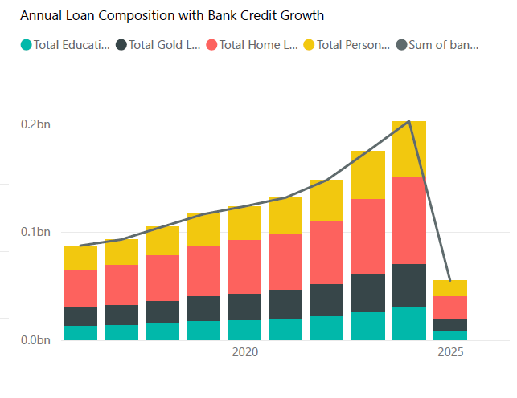
Chart 5 – Composition + Credit Growth
This chart combines a stacked column (composition) and a line chart (total credit growth) to offer a holistic picture of how the loan mix evolves alongside total disbursement.
Each color represents a loan type; the height shows yearly credit volume.
The line traces total growth, showing acceleration in most years.
Helps reveal which loan types drive growth vs. remain consistent.
This is a critical chart for understanding how portfolio balance impacts overall performance.

Slide 9
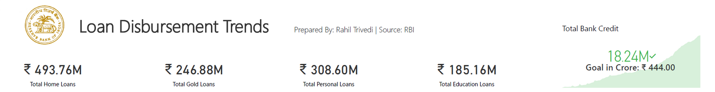
KPI Cards + Goal Progress
The KPIs at the top of the dashboard highlight total loan values by category:
₹493.76M Home Loans
₹246.88M Gold Loans
₹308.60M Personal Loans
₹185.16M Education Loans
In addition, a goal card tracks credit performance:
Credit Achieved: ₹18.24M
Goal: ₹444 Cr
These cards help monitor success metrics at a glance — perfect for quick executive updates.

Slide 10
Why I Created This Project
I created this project to strengthen my data storytelling, dashboarding, and real-time insight delivery skills.
Reasons behind this project:
Build a real-world financial dashboard from scratch
Practice transforming raw data (CSV) using SQL & Power Query
Present insights clearly for non-technical audiences
Prepare a strong portfolio asset for interviews and clients
This project reflects both technical ability and analytical thinking.

Slide 11
Conclusion – What I Learned
Throughout this project, I gained deep experience in both the technical and storytelling sides of data work.
Key takeaways:
Designing dashboards is about clarity, not complexity
Real-world datasets need data modeling and cleaning
The right chart choice changes how data is perceived
KPI cards, combo visuals, and slicers can turn data into strategy-ready tools
Most importantly: Telling the story behind the numbers is the real value of analytics
This project was more than visuals — it was a journey from raw data to decision-ready insights.

Slide 12
Thank You!
~Rahil Trivedi

